Slide 1
Top 7 Pivot Table tricks
Pre-requisite: Basics of Pivot Table

Slide 2
Pivot Table tricks
Grouping [Dates, Numbers]
Slicers & related settings
Pivot Chart Shortcut
Disable Autofit Column widths
Disable =GETPIVOTDATA() for formula writing
2-D Table data consolidation
Creating 100s of Pivot Table reports in < 1 minute

Slide 3
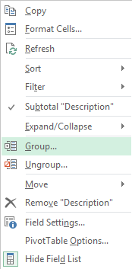
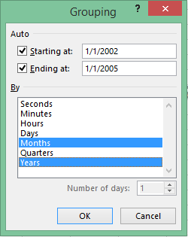
Grouping [Dates]

Slide 4
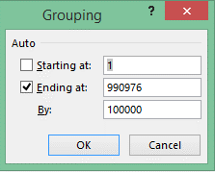
Grouping [Numbers]

Slide 5
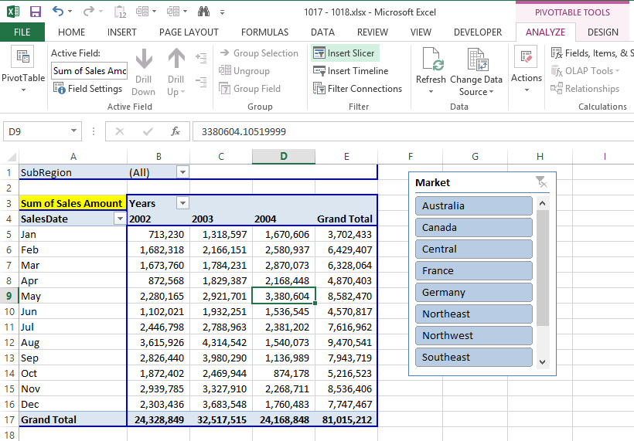
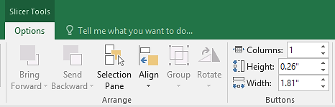
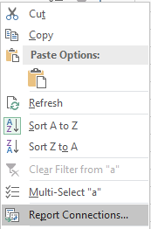
Slicers & related settings

Slide 6
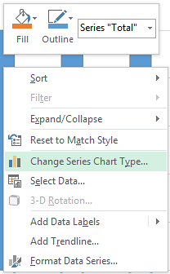
Pivot Chart Shortcut – F11

Slide 7
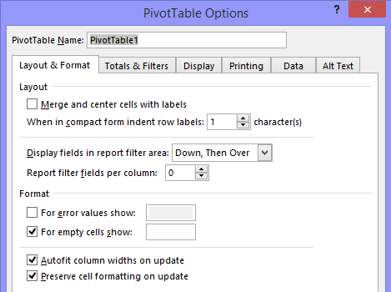
Disable Autofit Column widths

Slide 8
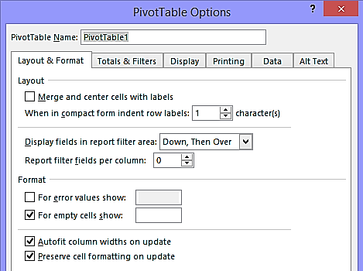
Disable Autofit Column widths

Slide 9
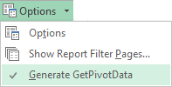
Disable =GETPIVOTDATA() for formula writing

Slide 10
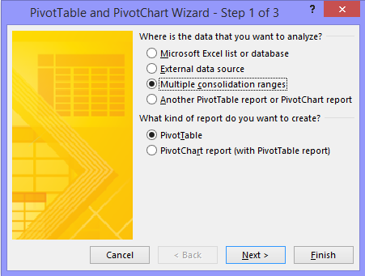
2-D Table data consolidation – Alt, D, P

Slide 11

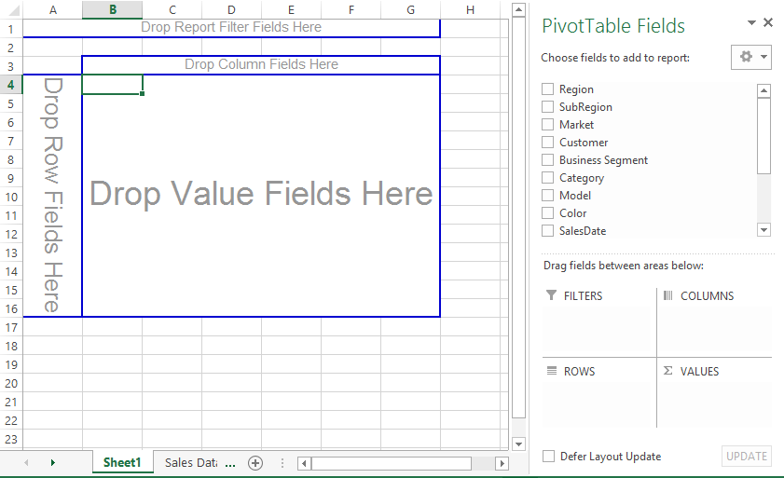
Creating 100s of Pivot Table reports in < 1 minute

Slide 12
Pivot Table tricks
Grouping [Dates, Numbers]
Slicers & related settings
Pivot Chart Shortcut
Disable Autofit Column widths
Disable =GETPIVOTDATA() for formula writing
2-D Table data consolidation
Creating 100s of Pivot Table reports in < 1 minute

Slide 13
Top 7 Pivot Table tricks

